Slide 1
Don’t forget to MD the recycle bin!
Kelly Brock
Takeda Fall Group Meeting 11/25/2015

Slide 2
Last time
Missense mutation project – sanity checks ok!
CIN project follow-up
  State machine based simulation

Slide 3
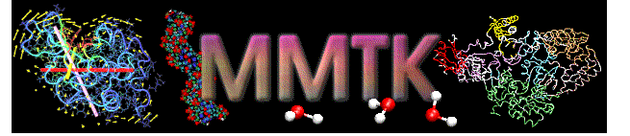

Goal for this week: get working MD simulation
http://structure.usc.edu/mmtk/
http://lammps.sandia.gov/

Slide 4
Status on both distributions
MMTK
  Ease of use
  Debugging installation (including python and netcdf4
LAMMPS
  Canonical, broad-use
  Easier installation, may be more difficult to implement
Other
  Use AMBER/CHARMM directly?
  GROMACS

Slide 5
Plan for working distro
Simulate barnase with added mutant based on original PDB
  Do for all possible mutations, compare to previously known
  Do multiple trials to get distribution of what “could happen”

Slide 6
Slipping into CIN
Want to perform state-machine based simulation to account for tetraploidy jumps
Initial code up and running
  Do parameter sweep to see what values are most likely to give distros

Slide 7
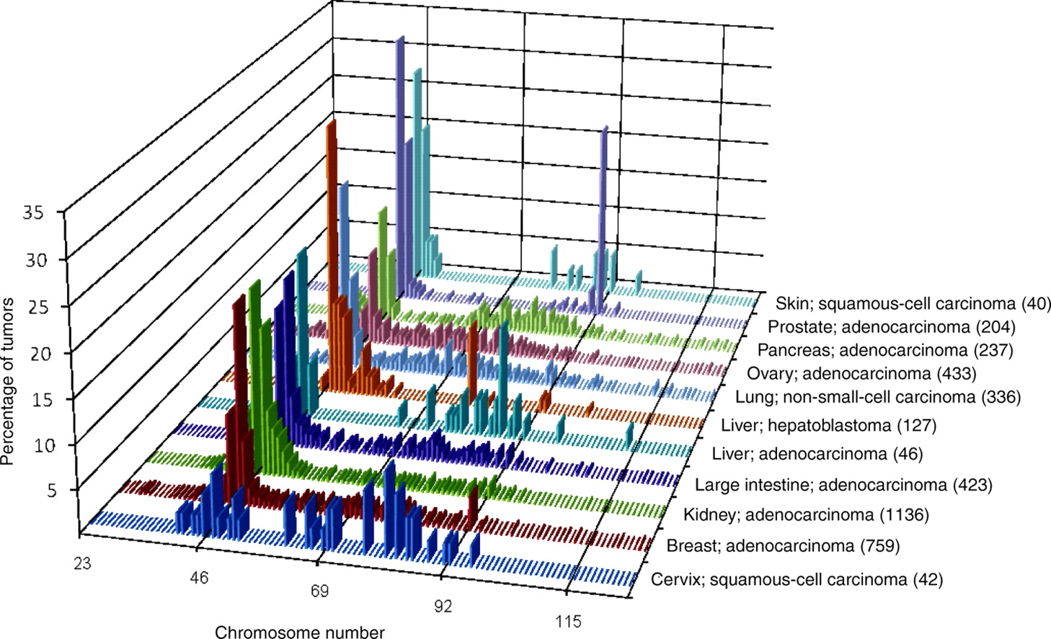
Confirming bimodality
Storchova and Kuffer, JCS 2008
http://jcs.biologists.org/content/121/23/3859
Notes:
“In fact, spontaneous unscheduled tetraploidization can be far more frequent than a gene mutation or chromosome-missegregation error.”

Slide 9
For the rest of this week/next week
Get working MD simulator!
Finish parameter sweep

